Slide 1
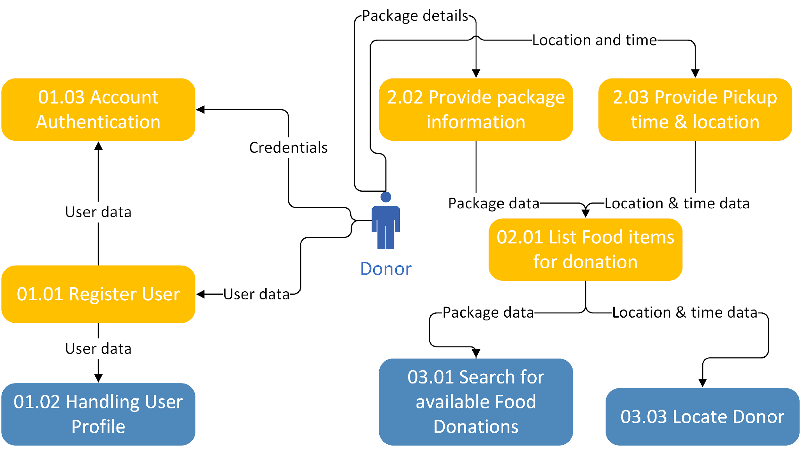
FoodPantry Data Flow Diagram(Logical)

